Slide 1
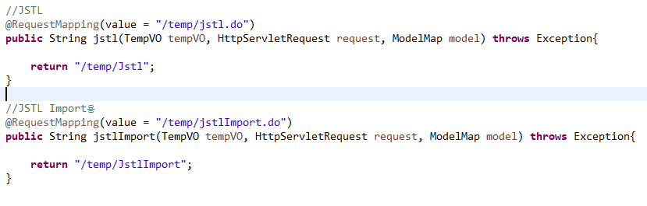
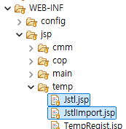

Slide 2
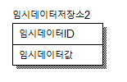

CREATE TABLE LETTEMP2
(
TEMP_ID CHAR(20) NOT NULL,
TEMP_VAL VARCHAR(100) NULL
);
ALTER TABLE LETTEMP2
ADD PRIMARY KEY (TEMP_ID);
ALTER TABLE LETTEMP2 COMMENT = '임시데이터저장소2';
ALTER TABLE LETTEMP2 CHANGE COLUMN TEMP_ID TEMP_ID CHAR(20) NOT NULL COMMENT '임시데이터ID';
ALTER TABLE LETTEMP2 CHANGE COLUMN TEMP_VAL TEMP_VAL VARCHAR(100) NULL COMMENT '임시데이터값';

Slide 3
INSERT INTO ids
(TABLE_NAME, NEXT_ID)
VALUES('TEMP_ID', 1);
<!-- TEMP START-->
<bean name="egovTempIdGnrService" class="org.egovframe.rte.fdl.idgnr.impl.EgovTableIdGnrServiceImpl" destroy-method="destroy">
<property name="dataSource" ref="egov.dataSource" />
<property name="strategy" ref="tempStrategy" />
<property name="blockSize" value="10"/>
<property name="table" value="IDS"/>
<property name="tableName" value="TEMP_ID"/>
</bean>
<bean name="tempStrategy" class="org.egovframe.rte.fdl.idgnr.impl.strategy.EgovIdGnrStrategyImpl">
<property name="prefix" value="TEMP_" />
<property name="cipers" value="15" />
<property name="fillChar" value="0" />
</bean>
<!-- TEMP END-->

